Slide 1

Insurance Database Management

Slide 2
Introduction
The Project aims to replicate an insurance company, who provides insurance services to cars, houses and health.
This model is built considering there are various branches across the country and many employees who work to increase the number of customers to company.
Customer can enroll into one or multiple policies and can choose the desired plan.

Slide 3
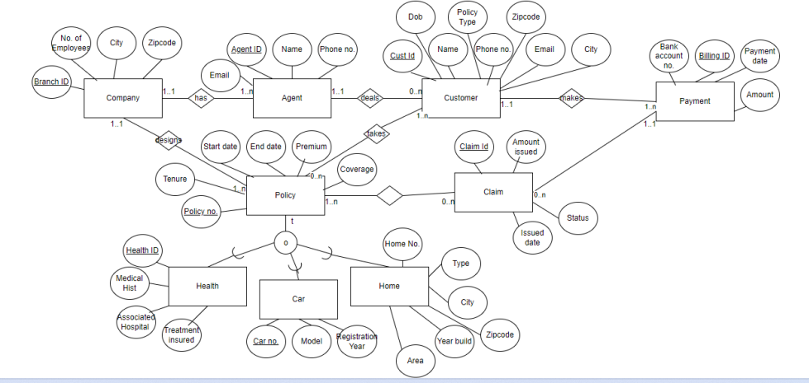
EER Diagram

Slide 4

Relational Model
Company ( Branch_ID, No_of_Employees, City, Zipcode)
Agent( Agent_ID, Email, Name , Phone_no, Branch_ID)
Customer ( Customer_ID, DoB, Name, Phone_no, Email, Policy_type, City, Zipcode, Agent_ID)
Payment ( Bank_acc_no , Billing_ID, Payment_date, Amount, Customer_ID)
Policy ( Policy_no, Tenure, Start_date, End_date, Premium, Coverage, Branch_ID)
Claim( Claim_ID, Amount_issued, Status, Issued_date, Billing_ID)
Health (Health_ID, Medical_history, Associated_hospital, Treatmen_insured, Policy_no)
Car (Car_no, Model, Registration_year, Policy_no)
Home (Home_no, Type, City, Zipcode, Year_built, Area, Policy_no)
Cust_Policy ( Customer_ID, Policy_no)
Claim_Policy ( Claim_ID, Policy_no)

Slide 5

Use case Problems
No. of customers and agents present in a particular city
List of top 5 performing agents
List of customers who took multiple policies.
Annual change in number of health insurances
Year wise revenue analysis
Categorization of the insurances according to their premium amount and count of customers in each category
Which age group of customers showed more interest to take insurance?

Slide 6
Visualizing the results
Bar graph to illustrate the number of customers to number of employees in that respective city.
Time series graph, which represent the change in number of policies and revenue.
Pie chart to demonstrate the number of policies taken by each age group.
Dynamic bar graph to demonstrate the number of policies in each category across various insurance types.

Slide 7
Features
If a customer is trying to pay more or less amount than his premium, the system would generate a error and will not allow the payment to process.
Sends an automated email to wish customers on their birthday every year.
User can choose the desired table and pass on the values in python to reflect on the database.

Slide 8
Challenges
Inserting data in “Payment” table as we had to insert multiple rows for the same user based on the start date of the insurance.
1
Creating dynamic visualization to demonstrate the various categorizations and number of customers who took that particular category across various policy types.
2
Sending an email to customer on their birthday.
3

Slide 9

Thank You

